Slide 1
Creating Self-healing Services with Circuit Breaker

Slide 2

Failures in a distributed system
Cascading failures
Circuit breaker pattern
Netflix Hystrix project
@EnableCircuitBreaker
@HystrixCommand
Hystrix Dashboard
@EnableHystrixDashboard
Turbine to aggregate Hystrix streams
@EnableTurbine
Outline

Slide 3
In a Distributed System one thing is absolutely certain
…

Slide 4
FAILURE
IS INEVITABLE

Slide 5
But why?

Slide 6






A Few Areas That Might Fail
Hardware fails
Networks fail
Software fails

Slide 7
That chance of
failure becomes multiplied
in a distributed system

Slide 8

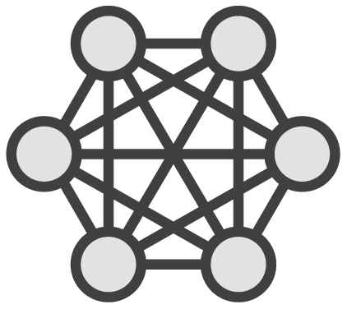




Process Communication Is Also More Likely to Fail
to …
Within the process
Across the network

Slide 9
Cascading Failure
“ … a failure in a system of interconnected parts in which
the failure of a part can trigger the failure of successive parts.”
- Wikipedia

Slide 10







Bad Side Effects: Cascading Failures
Service A
Service B
Service C

Slide 11

Multiple issues at play
Fault tolerance problem
Resource overloading problem

Slide 12
So, what can we do?
How can we solve this?

Slide 13

Learn to embrace failure
Tolerate failures
Gracefully degrade
Limit resources consumed
Constrain usage

Slide 14
Circuit Breaker Pattern
“… a design pattern in modern software development used to detect failures and encapsulates logic of preventing a failure to reoccur constantly …”
- Wikipedia

Slide 15


Circuit Breaker
Circuit closed
Circuit open

Slide 16
Fault Tolerance with Netflix Hystrix and Spring Cloud

Slide 17
Netflix Hystrix
Hystrix is a latency and fault tolerance library designed to stop cascading failure and enable resilience in complex distributed systems where failure is inevitable.
-Netflix Hystrix Project page

Slide 18

Implements the circuit breaker pattern
Wraps calls and watches for failures
10 sec rolling window
20 request volume
>= 50% error rate
Waits & tries a single request after 5 sec
Fallbacks
Protects services from being overloaded
Thread pools, semaphores, & cascading failures

Slide 19
Using Spring Cloud & Netflix Hystrix
pom.xml
<dependencyManagement>
<dependencies>
<dependency>
<groupId>org.springframework.cloud</groupId>
<artifactId>spring-cloud-dependencies</artifactId>
<version>Camden.SR2</version>
<type>pom</type>
<scope>import</scope>
</dependency>
</dependencies>
</dependencyManagement>

Slide 20
Using Spring Cloud & Netflix Hystrix
pom.xml
<dependency>
<groupId>org.springframework.cloud</groupId>
<artifactId>spring-cloud-starter-hystrix</artifactId>
</dependency>
<dependency>
<groupId>org.springframework.boot</groupId>
<artifactId>spring-boot-actuator</artifactId>
</dependency>

Slide 21
Using Spring Cloud & Netflix Hystrix
Application.java
@SpringBootApplication @EnableCircuitBreaker public class Application {
public static void main(String[] args) { SpringApplication.run(Application.class, args);
}
}

Slide 22
Using the @HystrixCommand Annotation
Service.java
@Soemrpvoince t
public class Service {
@HystrixCommand(fallbackMethod = "somethingElse")
public void doSomething() {
...
}
public void somethingElse() {
...
}
}

Slide 23

Be careful with Hystrix timeouts
Ensure timeouts encompass caller timeouts plus any retries
Default: 1000ms
hystrix.command.default.execution.isolation. thread.timeoutInMilliseconds=<timeout_ms>

Slide 24

Demo
Using the @EnableCircuitBreaker and
@HystrixCommand annotations

Slide 25
Monitor Hystrix Metrics in Real Time with the Hystrix Dashboard

Slide 26

What Is the Hystrix Dashboard?

Slide 27
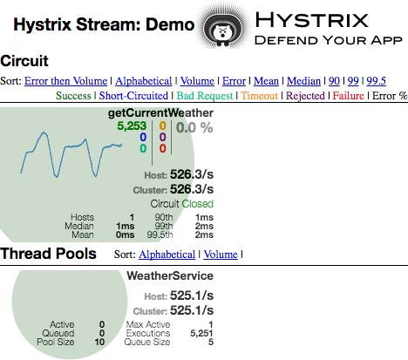
Tracks metrics such as
Circuit state Error rate Traffic volume
Successful requests Rejected requests
Timeouts Latency percentiles
Monitor protected calls
Single server or cluster

Slide 28
Using Spring Cloud & Netflix Hystrix Dashboard
pom.xml
<dependencyManagement>
<dependencies>
<dependency>
<groupId>org.springframework.cloud</groupId>
<artifactId>spring-cloud-dependencies</artifactId>
<version>Camden.SR2</version>
<type>pom</type>
<scope>import</scope>
</dependency>
</dependencies>
</dependencyManagement>

Slide 29
Using Spring Cloud & Netflix Hystrix Dashboard
pom.xml
<dependency>
<groupId>org.springframework.cloud</groupId>
<artifactId>spring-cloud-starter-hystrix-dashboard</artifactId>
</dependency>

Slide 30
Using Spring Cloud & Netflix Hystrix Dashboard
Application.java
@SpringBootApplication @EnableHystrixDashboard public class Application {
public static void main(String[] args) { SpringApplication.run(Application.class, args);
}
}

Slide 31
Understanding the dashboard
It contains a LOT of information in a little amount of space

Slide 32
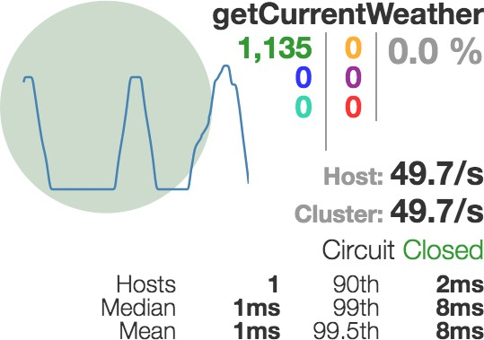
How to Read the Hystrix Dashboard
Circle size represents request volume
The protected call Error rate
Color represents health
Request per second
Request rate
(2 min)
Circuit state
Latency percentiles (1 min)

Slide 33
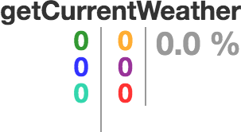
How to Read the Hystrix Dashboard

Slide 34
Demo
Using @EnableHystrixDashboard

Slide 35
Aggregating Hystrix Streams with Turbine

Slide 36

Viewing multiple Hystrix metrics, all at different URLs, could make you very grumpy!

Slide 37
Netflix Turbine
“Turbine is a tool for aggregating streams of Server-Sent Event (SSE) JSON data into a single stream…”
- Netflix Turbine Project Page

Slide 38
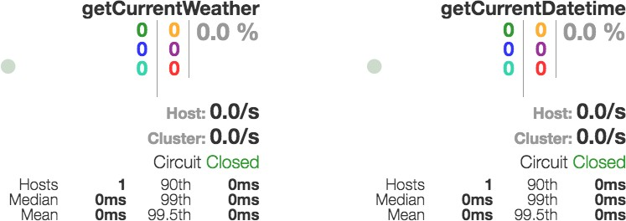
Multiple Hystrix Streams in One View on the Hystrix Dashboard
Stream located at
localhost:8080
Stream located at
localhost:8181

Slide 39
Using Spring Cloud & Netflix Turbine
pom.xml
<dependencyManagement>
<dependencies>
<dependency>
<groupId>org.springframework.cloud</groupId>
<artifactId>spring-cloud-dependencies</artifactId>
<version>Camden.SR2</version>
<type>pom</type>
<scope>import</scope>
</dependency>
</dependencies>
</dependencyManagement>

Slide 40
Using Spring Cloud & Netflix Turbine
pom.xml
<dependency>
<groupId>org.springframework.cloud</groupId>
<artifactId>spring-cloud-starter-turbine</artifactId>
</dependency>

Slide 41
Using Spring Cloud & Netflix Turbine
Application.java
@SpringBootApplication
@EnableTurbine
public class Application {
public static void main(String[] args) { SpringApplication.run(Application.class, args);
}
}

Slide 42
Using Spring Cloud & Netflix Turbine
application.properties
turbine.app-config=<list_of_service_ids> turbine.cluster-name-expression=’default’
OR
application.yml
turbine:
appConfig: <list_of_service_ids> clusterNameExpression: ”’default’”
* In addition to the standard spring application name and discovery server location properties

Slide 43
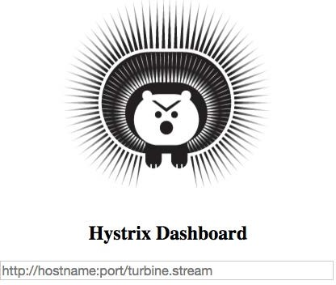
Netflix Turbine and the Hystrix Dashboard

Slide 44
Demo
Using @EnableTurbine

Slide 45
Fault tolerance is a requirement
Netflix Hystrix
Summary
Circuit breaker pattern
@HystrixCommand &
@EnableCircuitBreaker
Netflix Hystrix Dashboard & Turbine
Monitor one or several streams

